Slide 1


SECURITY AND PRIVACY ISSUES OF ZOOM
BY,
ADITHYA HOLLA K
4NM19CS007
ASHRITHA
4NM19CS033

Slide 2

Introduction Of Zoom
Zoom is an online meeting platform
It can be used to make 1-1 or group video
Users can screen-share , share ,chat and use interactive features
It unifies cloud video conferencing
It is a cloud Based Video communication

Slide 3
Zoom Security Issues
Due to serious Allegations many users still think Zoom is not safe.Serious security vulunerabilities , cyber attacks, meeting –crashes .
Types of Zoom Security Issues:
Zoom’s Vulnerability to Brute Force Attacks
Zoom chat security issues
Zoom’s Vulnerability to Brute Force Attacks
Zoom’s Weak Anti-Tampering Mechanisms
Zoom’s Windows Security Issues

Slide 4
How Zoom Overcome The Security Issues
The default password Should be no longer than six
It allows manually to change the default password
Should be disable GIPHY
They integrated “ CAPTCHA”
To overcome the issues zoom Issue patched version of the software

Slide 5
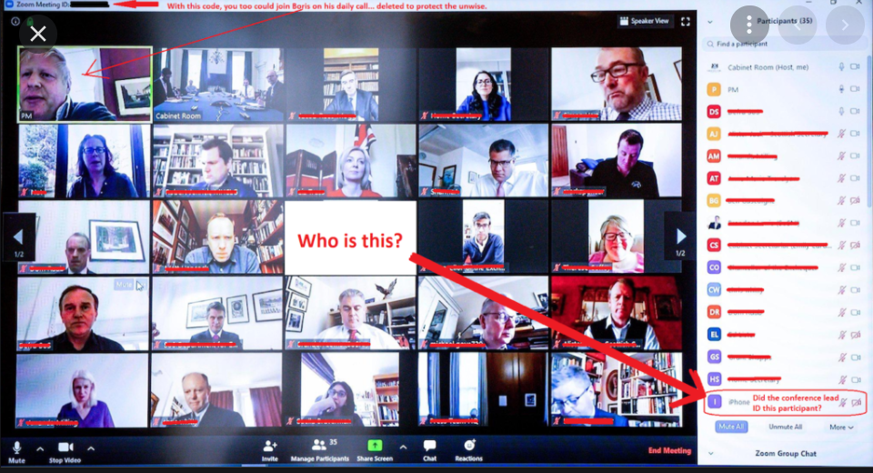
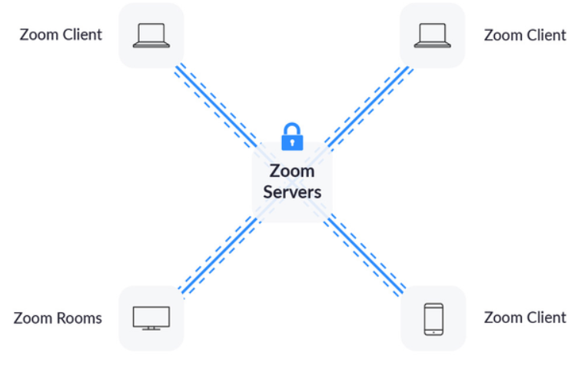
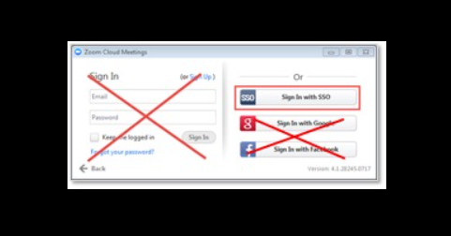
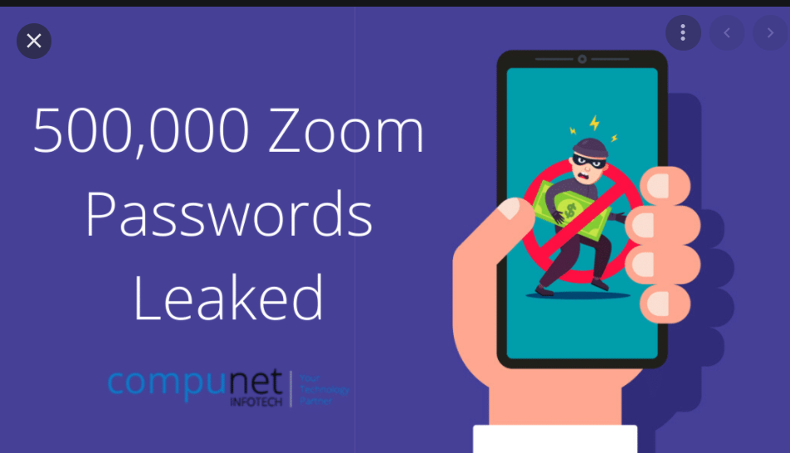
Privacy Issues Of Zoom
The privacy issues of zoom are :
Zoom Bombing
Unsecure Desktop
Leaked Password
False End- to- End Encryption
The camera hacking bug

Slide 6
How Zoom overcome The Privacy Issues
Steps taken by the zoom to overcome the privacy issues are:
Privacy Statement
Privacy Notifications
Creates council of CISOs
Conducting a comprehensive review with third-party experts and representative

Slide 7
Zoom quickly announced that it was removing the Facebook software
The company will be joining other major social platforms like Google and Facebook in providing regular transparency reports to inform users about any requests for their records.
Regularly share information about privacy and security improvements they’ve implemented.
Engaging a series of simultaneous white box penetration tests to further identify and address issues.

Slide 8


